Slide 1
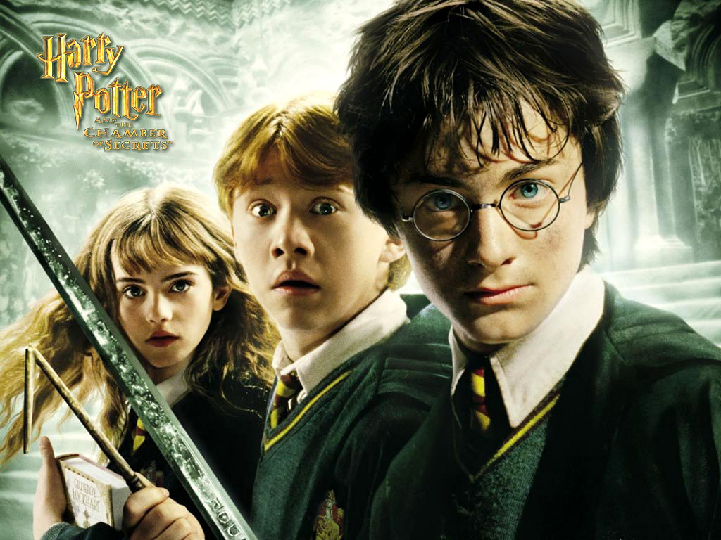

Slide 2
I had high expectations for the Harry Potter series because it had been so well known all over
I would recommend this book to a teenager around the age of Harry so they can relate to him. Also they need to have read the first book, Harry Potter and the Sorcerers Stone, to get a full grasp of exactly what's happening

Slide 3
Personal Evaluation
I give the book 5/5 stars
I give the book 5/5 stars because it kept my attention more then any book I’ve ever read
Once you get in the middle of the book there is always something huge happening drawing you in to every page.

Slide 4
Summary
Harry is getting ready for another year at Hogwarts after his first one didn’t go as well as he hoped.
Throughout the year Harry finds out things no one knows about the including some of the administration.
His friendship with Ron and Hermione build as well along the way

