Slide 1
Tuesday’s with Morrie
By Mitch Albom
Presentation by Brenna Adkins

Slide 2
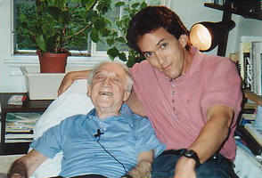
About Tuesday’s with Morrie
True story
  Based on Mitch Albom’s interactions with Morrie Schwartz
  Mitch wrote the book about Morrie
  Published in 1997
Book written to share Morrie’s life lessons
  Morrie was extremely wise
  Always had a lesson to teach to whomever would listen
Morrie was Mitch’s old professor in college
  Mitch’s favorite professor
  They were very close during Mitch’s college years
  Sadly lost contact for many years

Slide 3
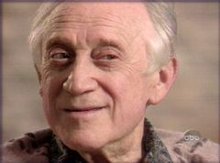
About Tuesday’s with Morrie
When Morrie was his professor, he taught sociology
  taught about people, life, and other topics
  touched many people’s lives
Morrie sadly developed the disease ALS (amyotrophic lateral sclerosis)
  causes nerve cells to gradually break down and die
  debilitating disease with no cure found to this day
Mitch got back in touch with Morrie
  began seeing him regularly on every Tuesday
  Morrie knew he was going to die
    wanted Mitch to start documenting their time together
  Mitch would record the audio from their times together
After Morrie died, Mitch wrote this book
  Morrie asked Mitch to do so

Slide 4
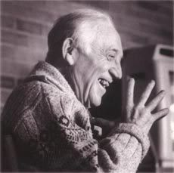
The Story
Each chapter in the book is a different life lesson Morrie taught
  After the first few chapters, the book starts talking about specific Tuesdays
    There were a total of fourteen Tuesdays that Mitch and Morrie spent together
Many lessons told, but my personal favorite was . . .
  11th Tuesday, We Talk About Our Culture
    “Well, for one thing, the culture we have does not make people feel good about themselves. We're teaching the wrong things. And you have to be strong enough to say if the culture doesn't work, don't buy it. Create your own. Most people can't do it.” ― Mitch Albom, Tuesdays with Morrie
  Morrie then explains to Mitch how to create a culture with the people you love
All chapters are formatted this way
  Morrie teaches from a personal story
  Then gives quotable advice on how to apply the lesson from the story to life

Slide 5
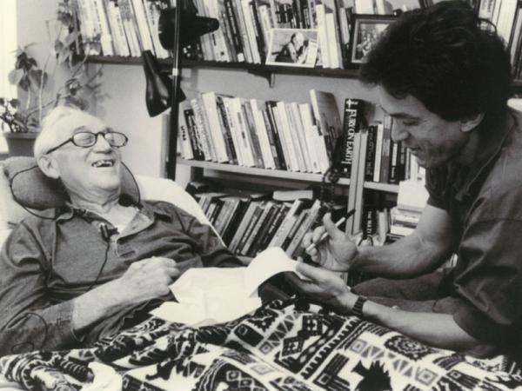
Lessons Taught by Morrie
The World
Feeling Sorry for Yourself
Regrets
Death
Family
Emotions
Fear of Aging
Money
Love
Marriage
Our Culture
Forgiveness
The Perfect Day
Saying Goodbye

Slide 6
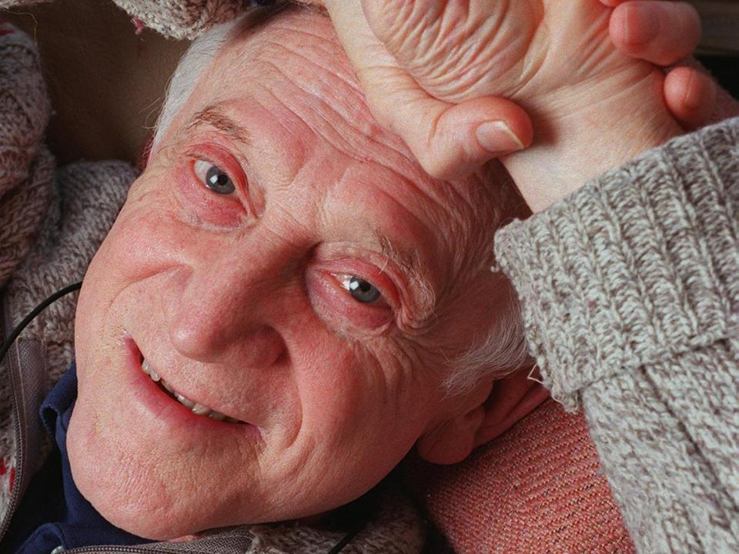
Favorite Quotes
“So many people walk around with a meaningless life. They seem half-asleep, even when they're busy doing things they think are important. This is because they're chasing the wrong things. The way you get meaning into your life is to devote yourself to loving others, devote yourself to your community around you, and devote yourself to creating something that gives you purpose and meaning.” ― Mitch Albom, Tuesdays with Morrie
“Love wins, love always wins.” ― Mitch Albom, Tuesdays with Morrie
“Devote yourself to loving others, devote yourself to your community around you, and devote yourself to creating something that gives you purpose and meaning.” ― Mitch Albom, Tuesdays with Morrie
“There is no such thing as 'too late' in life.” ― Mitch Albom, Tuesdays with Morrie
“Accept who you are; and revel in it.” ― Mitch Albom, Tuesdays with Morrie
“People are only mean when they are threatened.” ― Mitch Albom, Tuesdays with Morrie

Slide 7
The Purpose of Tuesday’s with Morrie
Morrie’s guide to living well
  After becoming sick, Morrie asked Mitch to write this for him
  Didn’t want people to go through life without really living
  Recorded every talk they had together just for the purpose of writing this book
Self help
  Morrie wanted his knowledge to be applied to other’s lives
  Wanted to improve the world around him
Purpose fulfilled
  Morrie achieved his goal with this book
    So many lives were changed because of the lessons taught

Slide 8

Book Evaluation
Out of five stars, I give Tuesday’s with Morrie five stars
This book definitely lived up to the hype
  Some schools even make reading it a requirement
    “I am now regularly using this book in my class. It is required reading. All, and I do mean all, of my students have said that it is the best book they have ever read.” - Myra Wood Bennett, MSW, Grantsburg, Illinois
    My mom is a teacher and requires the book for her seniors
  Many have said this book has changed their lives
    “I bookmarked pages in your book, I read parts to my children. Thank you for a story I shall carry in my heart for the rest of my life.” - Diane Gaul Coveleski, Union City, Pennsylvania
Overall, amazing and inspiring story that deserves very high praise

Slide 9
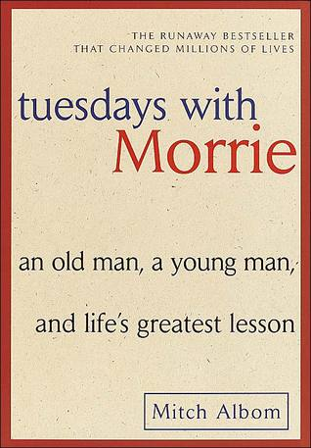
Recommendations
I would recommend this book for many people
  young adults who are seeking guidance
    many life lessons are taught in the book
  people wanting to read a well-written, nonfiction book
    interesting yet still true
  people who are looking for an inspirational story
    one of the most inspiring books I’ve ever read
  seniors in high school especially
    about to go into the real world
    need to know what’s actually important in life

