Slide 1
“So what about skyscrapers for dead people that were built down? They could be underneath the skyscrapers for living people that are built up.”

Slide 2
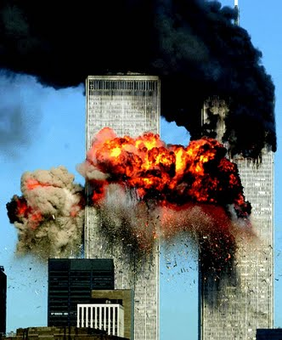
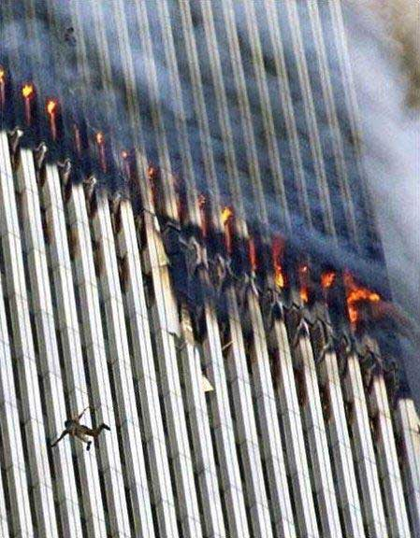

Slide 3
A tragedy that affected everyone,
But
This is a story of...

Slide 4
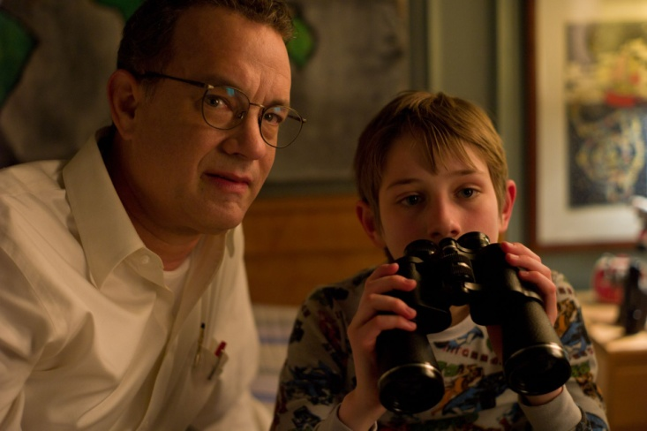
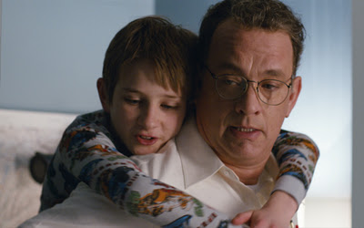
A boy who fell apart
Trying not to forget...

Slide 5
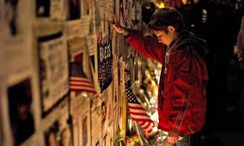
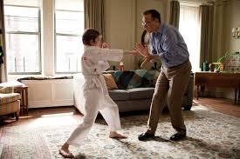
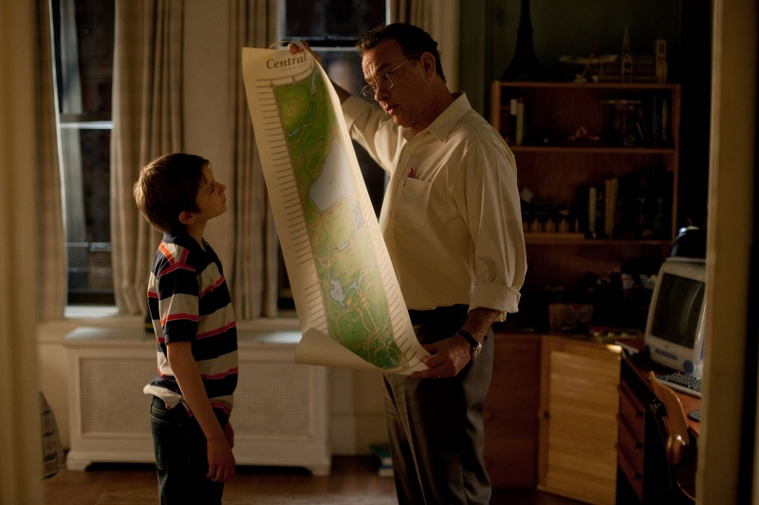

Slide 6
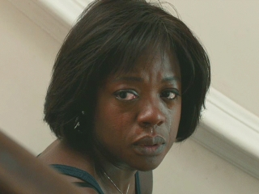
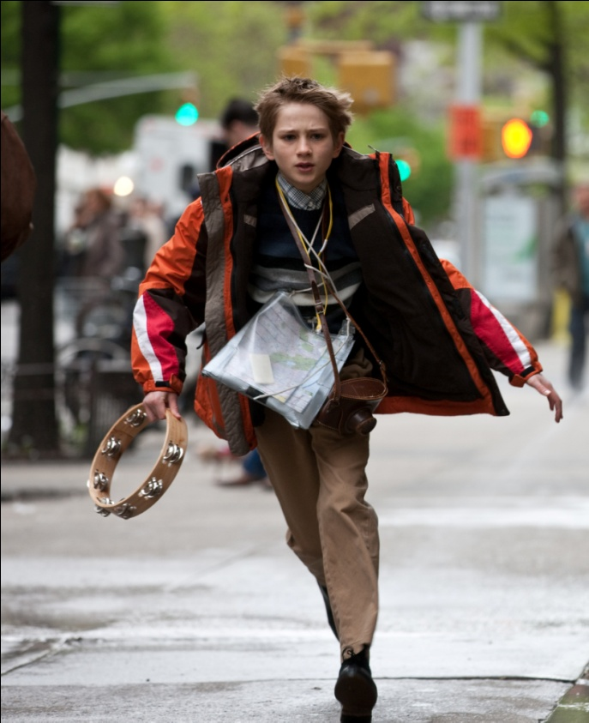
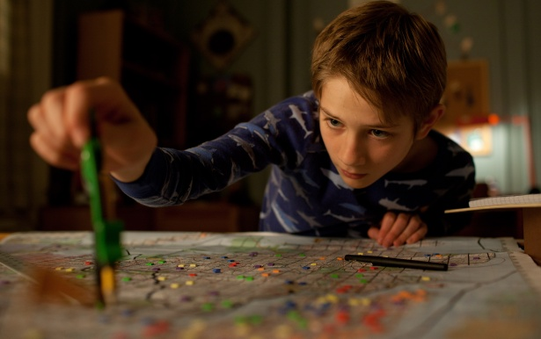
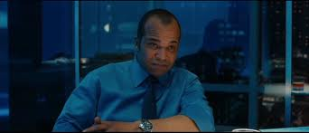
So he goes on a journey

Slide 7
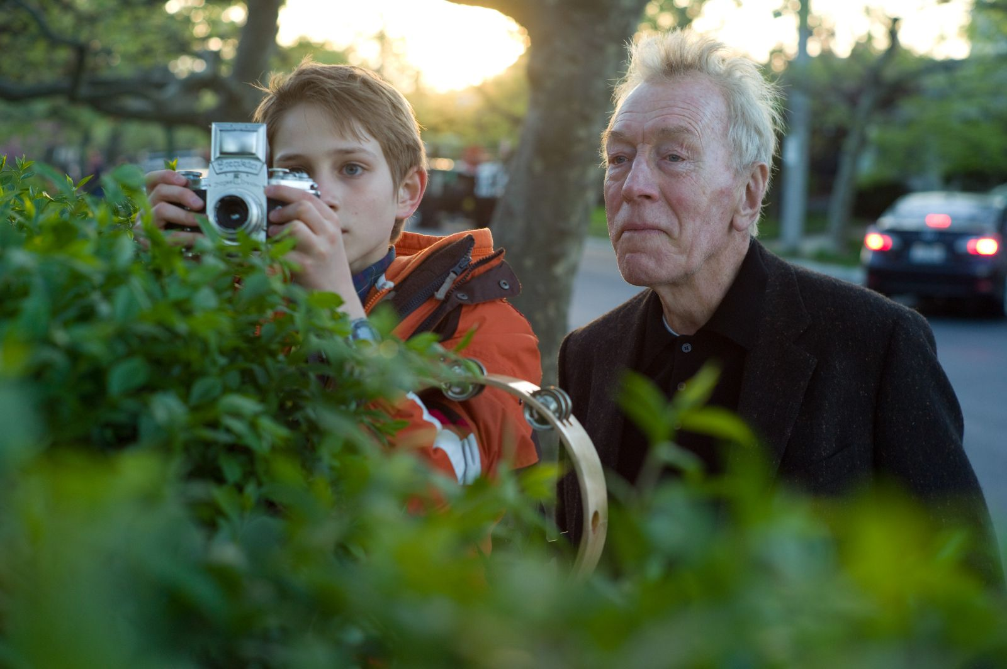
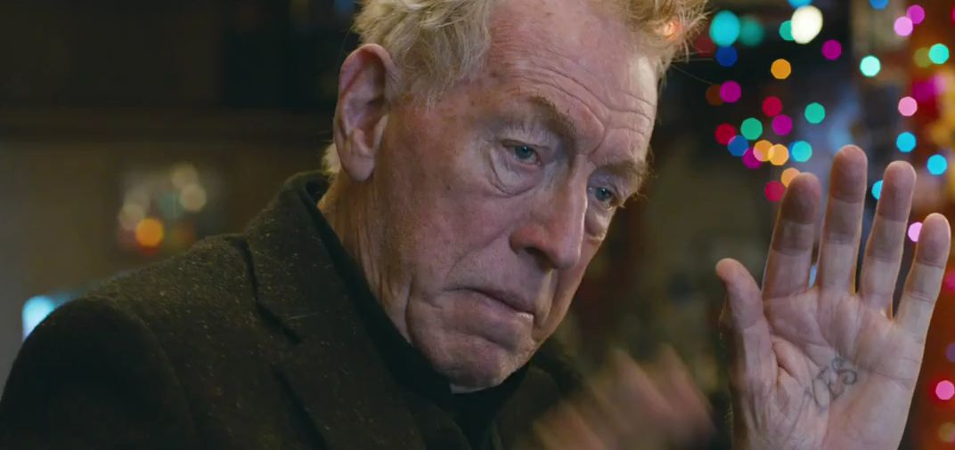
To find
Out what
the key belongs too.

Slide 8
“If things were easy to find, they wouldn’t be worth finding.”

Slide 9
“Kept me on the edge of my seat.”
“A little confusing, but was a great book.”
“Better than the movie.”
“So sad that 911 even happened.”
“Tear-jerking”

Slide 10
Extremely Loud
&
Incredibly Close
By: Jonathan Safran Foer

