Slide 1
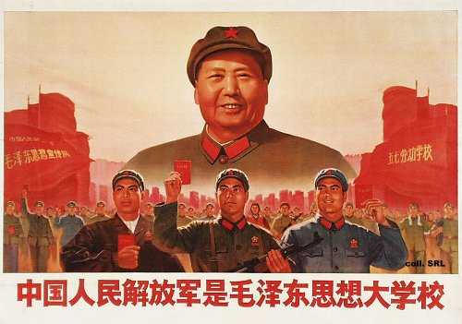
After the Great Leap Forward Movement collapses in China, Emperor Moa Zedong established another movement called the Great Proletarian Cultural Revolution to reestablish socialism.

Slide 2
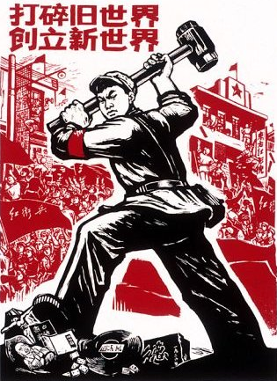
Moa declared that all
traditional customs and
beliefs needed to be
destroyed and rebuilt,
which he appointed
teenagers to form an army
called the Red Guard to
enforce this.

Slide 3
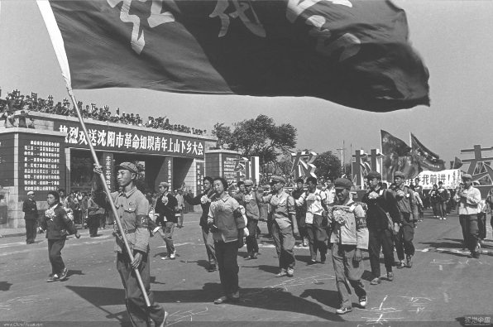
The youth took
Extreme actions in
Creating Moa’s dream,
such as severe beatings
of most educated
adults, and caused
mass suicides for
the terrified older
generations.

Slide 4
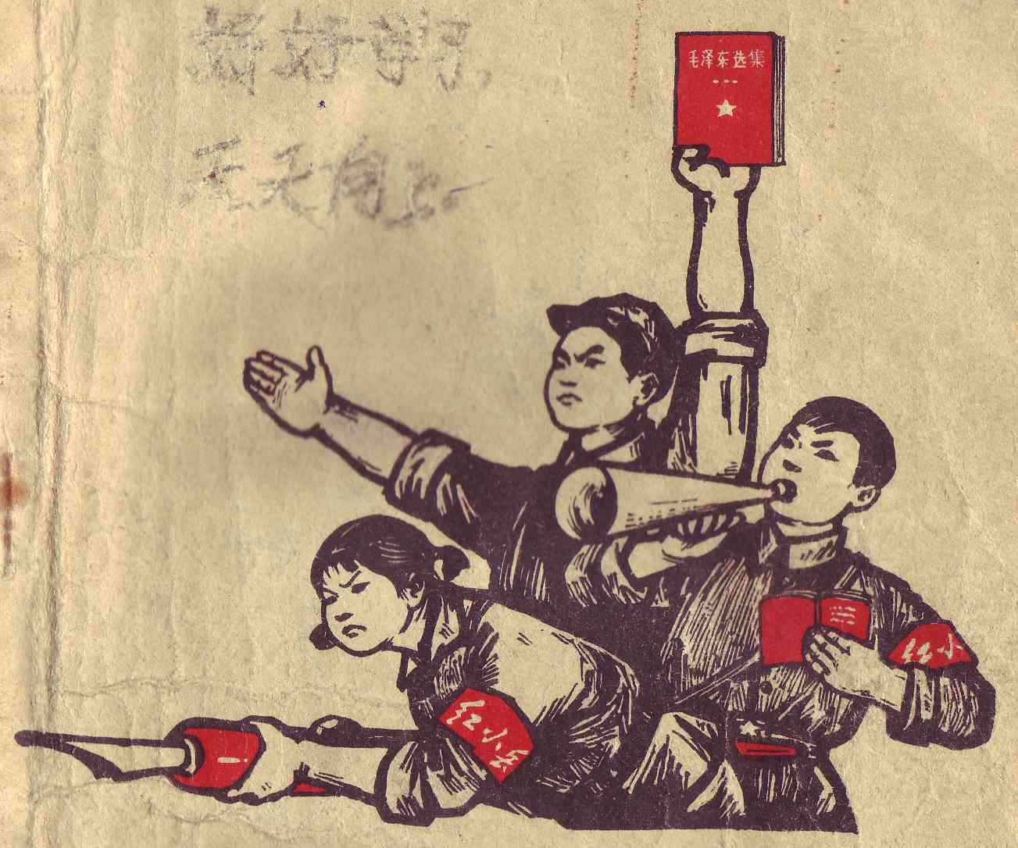
The Author, Goa Yuan,
lived as a Red Guard
member in the center
of this movement.

Slide 5
This is his story…

Slide 6
The book that
exceeds all reviews!

Slide 7
Most people said it was
good and eye opening,
but it was way better than
good, and put a whole
New perception to
Different areas of the
world.

Slide 8
Virtually everyone should read this book eventually in their lives, but people educated in History would appreciate the book most.

Slide 9
It has some complex vocabulary and lingo so the person should at least be in high school and should read the foreword prior to reading.

Slide 10
The book is an all around intriguing story that makes you put yourself in someone else’s life. The personality in the book gives you a close relationship to the author and makes you laugh, cry, worry, and smile.
However, it does lag on a bit in the middle.

Slide 11
So I give this book a
9 out of 10!

Slide 12
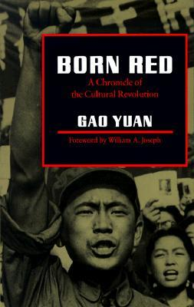
Born Red:
Chronicles of
the Cultural Revolution
By:
Gao Yuan

