Slide 1
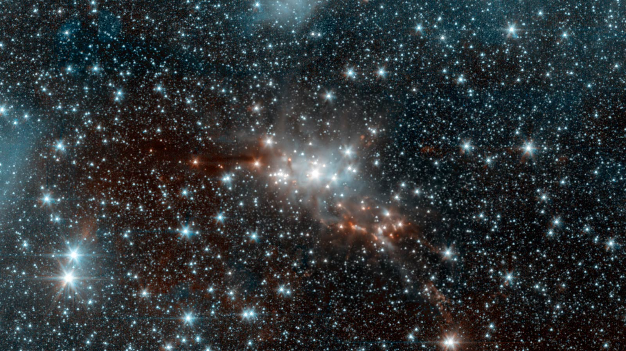
Morgan
Baldwin
John Green

Slide 2
Plot Outline
A 17 year old girl named Hazel continues through her tough medical conditions and hangs on to the things she has. Along her journey, she meets a special someone and she realizes what obstacles she can go through with him and meets some new friends along the way. Her life is turned around from being the most lonely sheltered girl, to one that takes chances and realizes what she can and cant do with her devastating cancer life.

Slide 3
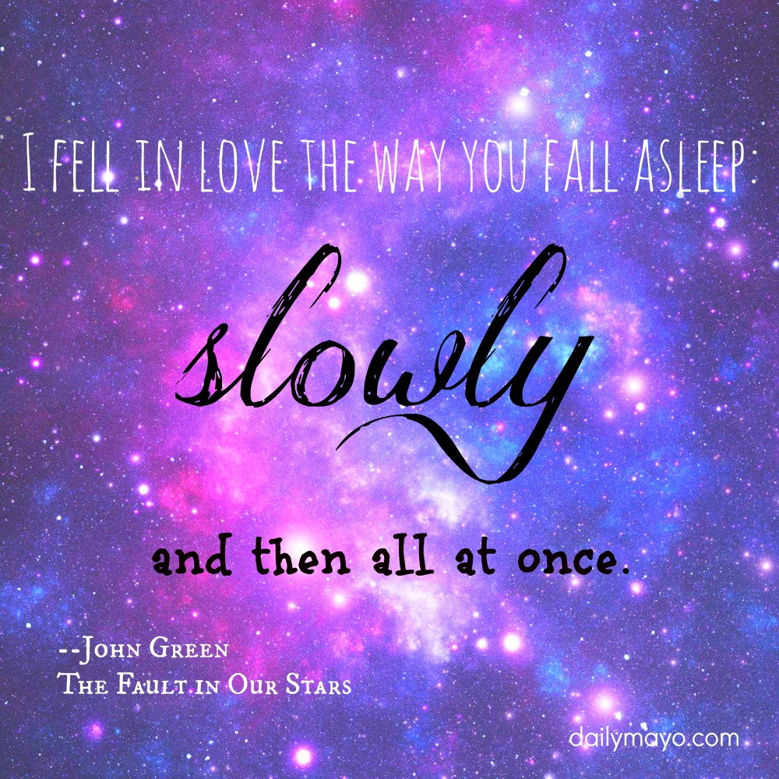

Slide 4
Recommendation
I would recommend this book for teenagers and young adults who love a heart warming chick flick. This book not only will make you cry, but will make you want to read more and more of the story. For all of the John Green fans out there, I would highly recommend this book. He not only has great word placement, but can catch your full attention as if you're lost in the book.

Slide 5
Evaluation
- I would give this story five stars because John Green is one of my favorite writers and he's excellent at capturing the reader’s full attention. His writing makes you feel what is going on in the novel and really explains the true morals and meanings of the sensitive stories. When you’re in the mood to read a heart warming, yet humorous story, this book is the one for you.

Slide 6
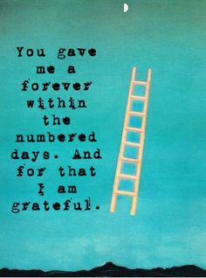
Expectations…
When I started reading this book, I expected to know all of the characters well and to be blown away by the plot of the story. John Green did an exceeding job at finishing the book with a strong ending, even though it will make all of our hearts melt.

Slide 7
Author’s Purpose
The author’s purpose of the story was to express what he felt after losing one of his friends that has passed away from thyroid cancer.

