Slide 1
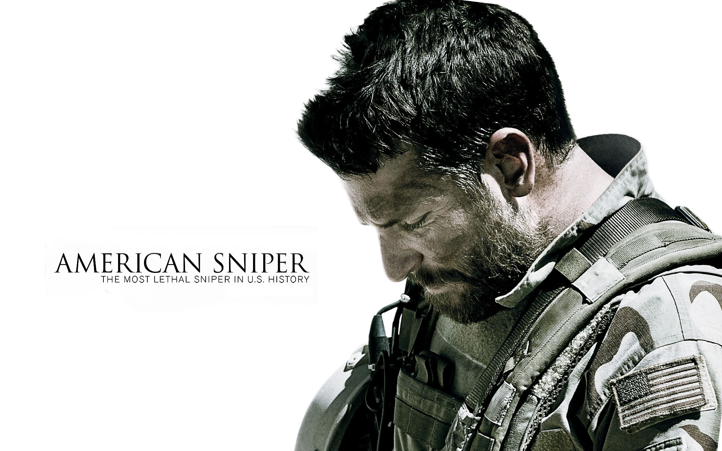
American Sniper

Slide 2
Expectations:
I did have a lot of expectations for the book because I watched the movie and it was amazing.
The book turned out even better by how many more details the book had then the movie.
You really feel like you can experience what happened to him better in the book.
The movie does give you a good visual of all the characters when you are reading the book though.

Slide 3
Book Recommendations:
I would recommend this book to someone who is very patriotic and wants to learn the life of a navy seal.
Action filled
Documentary
Drama
Connections with all the characters

Slide 4
Plot:
Chris Kyle a cowboy from Texas wants to do something more with his life so he joins the Seals. He then finds out he has a knack for shooting a sniper. He then makes a reputation for himself that makes him known as “The Legend”. He is good at fighting battles in Afghanistan but he is still battling to keep his wife and family at home since he is gone so much.

Slide 5
Personal Evaluation: 5 stars
I give this book 5 stars out of 5 because this is the best book I have ever read in my life it is so patriotic and it can really show you valuable lessens in life that you need to learn from. It really shows you what them guys go through everyday oversees for us and people need to realize how much they sacrifice for all of us.

Slide 6
What this book is mainly about:
Chris Kyle and his journey from a young guy in Texas too a American hero that may seem perfect in battle but by the end of the day he still has his on problems to face including his family and kids back home.

Slide 7
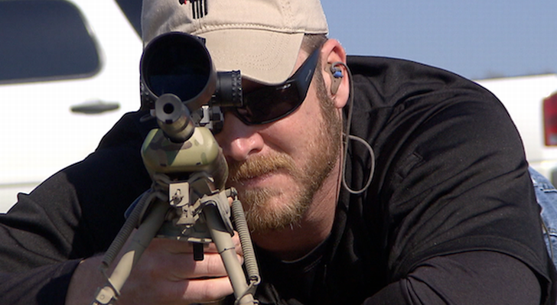
“The Legend” Chris Kyle

